Slide 1



UNIVERSITY ADMISSION
PREDICTION
by
(Machine Learning)

Slide 2

What is Machine Learning???
Machine Learning is a sub-area of artificial intelligence, whereby the term refers to the ability of IT systems to independently find solutions to problems by recognizing patterns in databases.

Slide 3


Problem Statement & Solution:
Problem Statement is to find whether a student get admission in an university by taking analysis of his marks.
So, to solve all these problems we are implementing a prediction using Machine Learning.

Slide 4
Data Collection:
https://www.kaggle.com/mohansacharya/graduate-admissions
GRE Score
TOEFL Score
Statement of Purpose
Letter of Recommendation University Ranking
CGPA
Research
Serial No. | GRE Score | TOEFL Score | University Rating | SOP | LOR | CGPA | Research | Chance of Admit
1 | 337 | 118 | 4 | 4.5 | 4.5 | 9.65 | 1 | 0.92
2 | 324 | 107 | 4 | 4 | 4.5 | 8.87 | 1 | 0.76
3 | 316 | 104 | 3 | 3 | 3.5 | 8 | 1 | 0.72
4 | 322 | 110 | 3 | 3.5 | 2.5 | 8.67 | 1 | 0.8
5 | 314 | 103 | 2 | 2 | 3 | 8.21 | 0 | 0.65

Slide 5
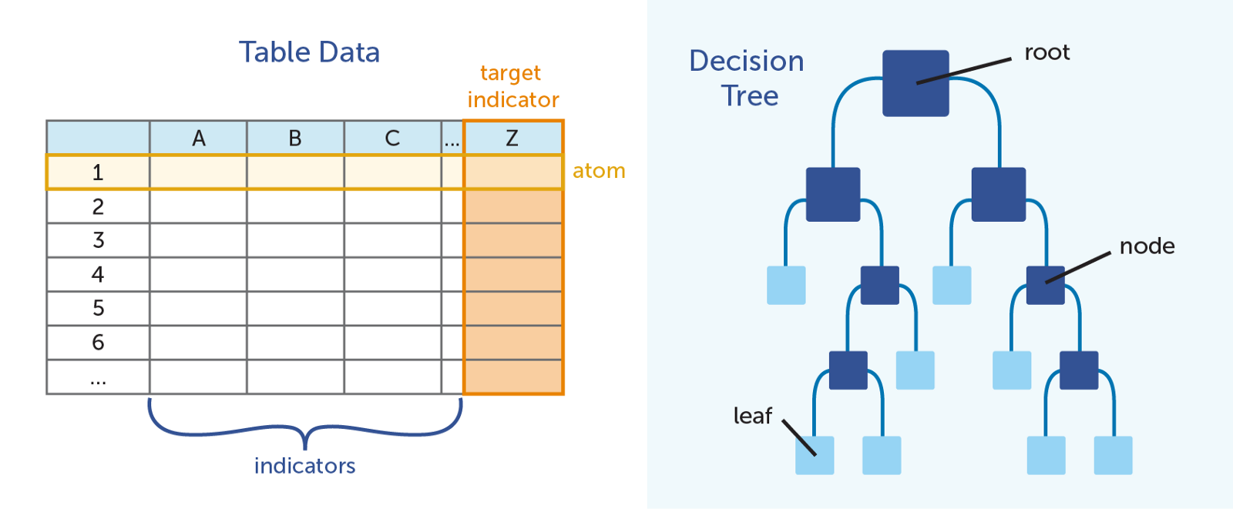
Data Modeling:
Best method to predict our problem statement: Decision Tree Regression
Decision tree builds regression or classification models in the form of a tree structure. It breaks down a dataset into smaller and smaller subsets while at the same time an associated decision tree is incrementally developed. Decision trees can handle both categorical and numerical data.
Libraries that import DecisionTree Regression:
from sklearn.tree import DecisionTreeRegressor

Slide 6
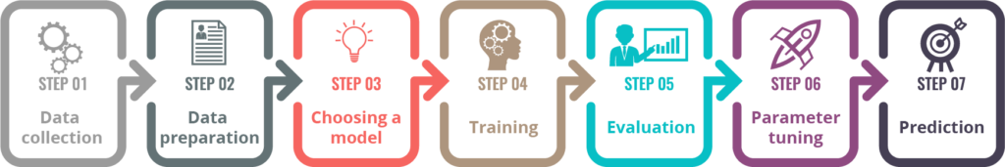
Steps for Prediction:
1.Firstly Import “numpy,pandas,matplotlib” 4.Importing “DecisionTree Regression” librabries algorithm from “Sklearn” library
2.Upload Dataset to Jupiter Notebook 5.Training Data
3.Slicing the Independent and Dependent 6.Testing Data
variables 7.Prediction
Finally we Deploy our Model!!!

Slide 7
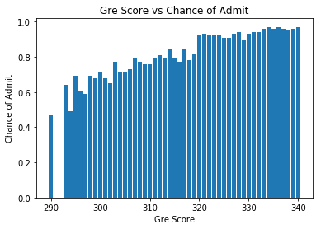
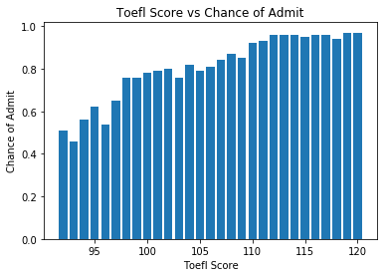
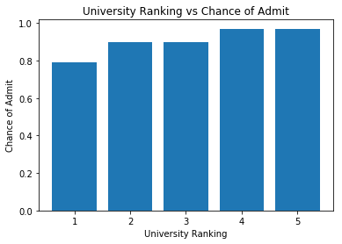
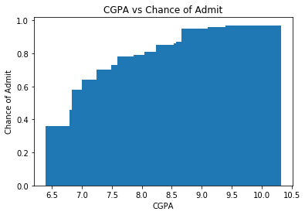
Visualization:

Slide 8
Conclusion:
Finally we conclude that instead of waiting to get admit card from university . By using Machine Learning prediction we can easly predict wheather a student get admission in a particular university or not.

